Slide 1
UIView and CALayer

Slide 2
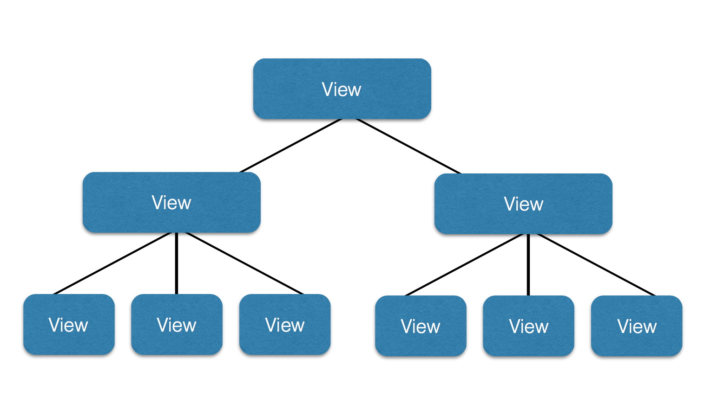
UIView Hierarchy

Slide 3
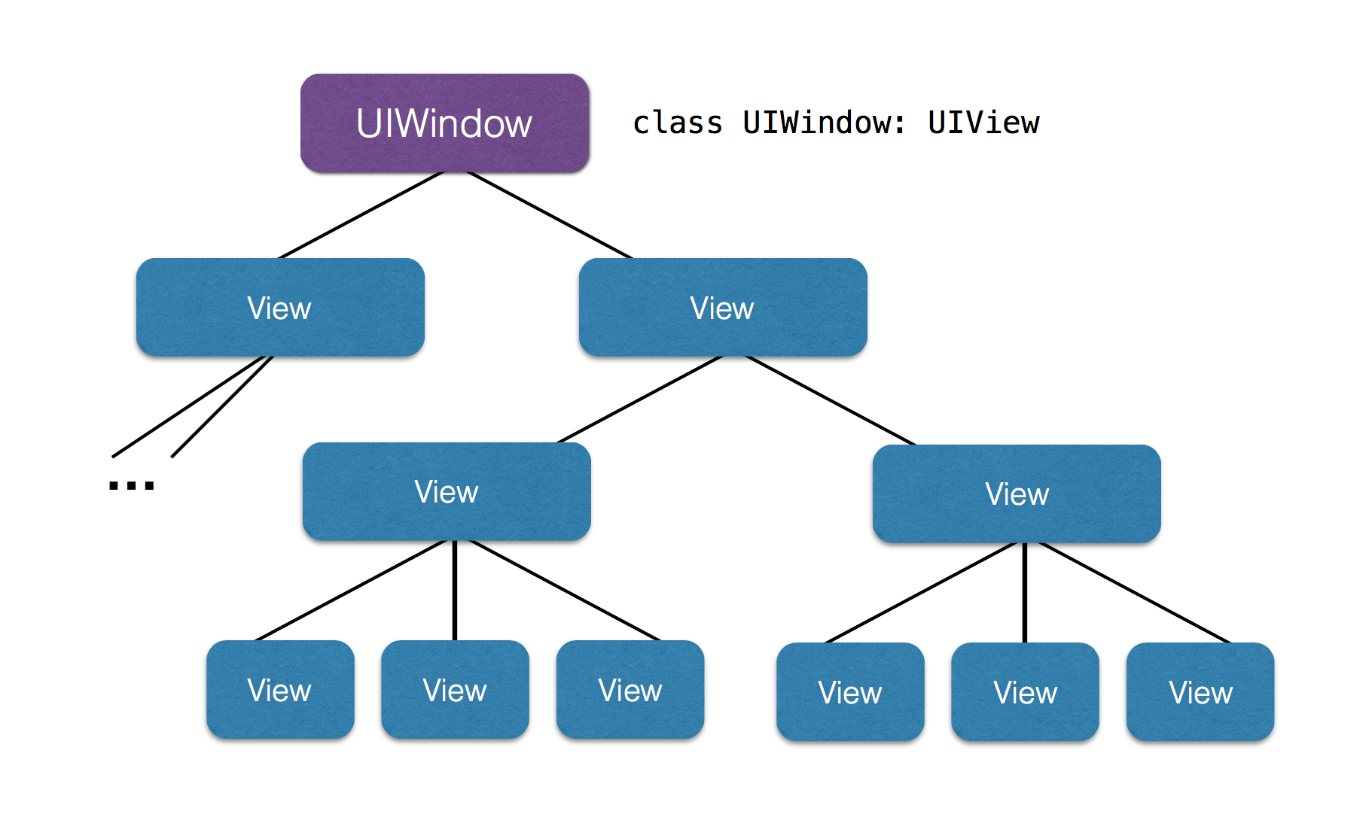
UIWindow

Slide 4
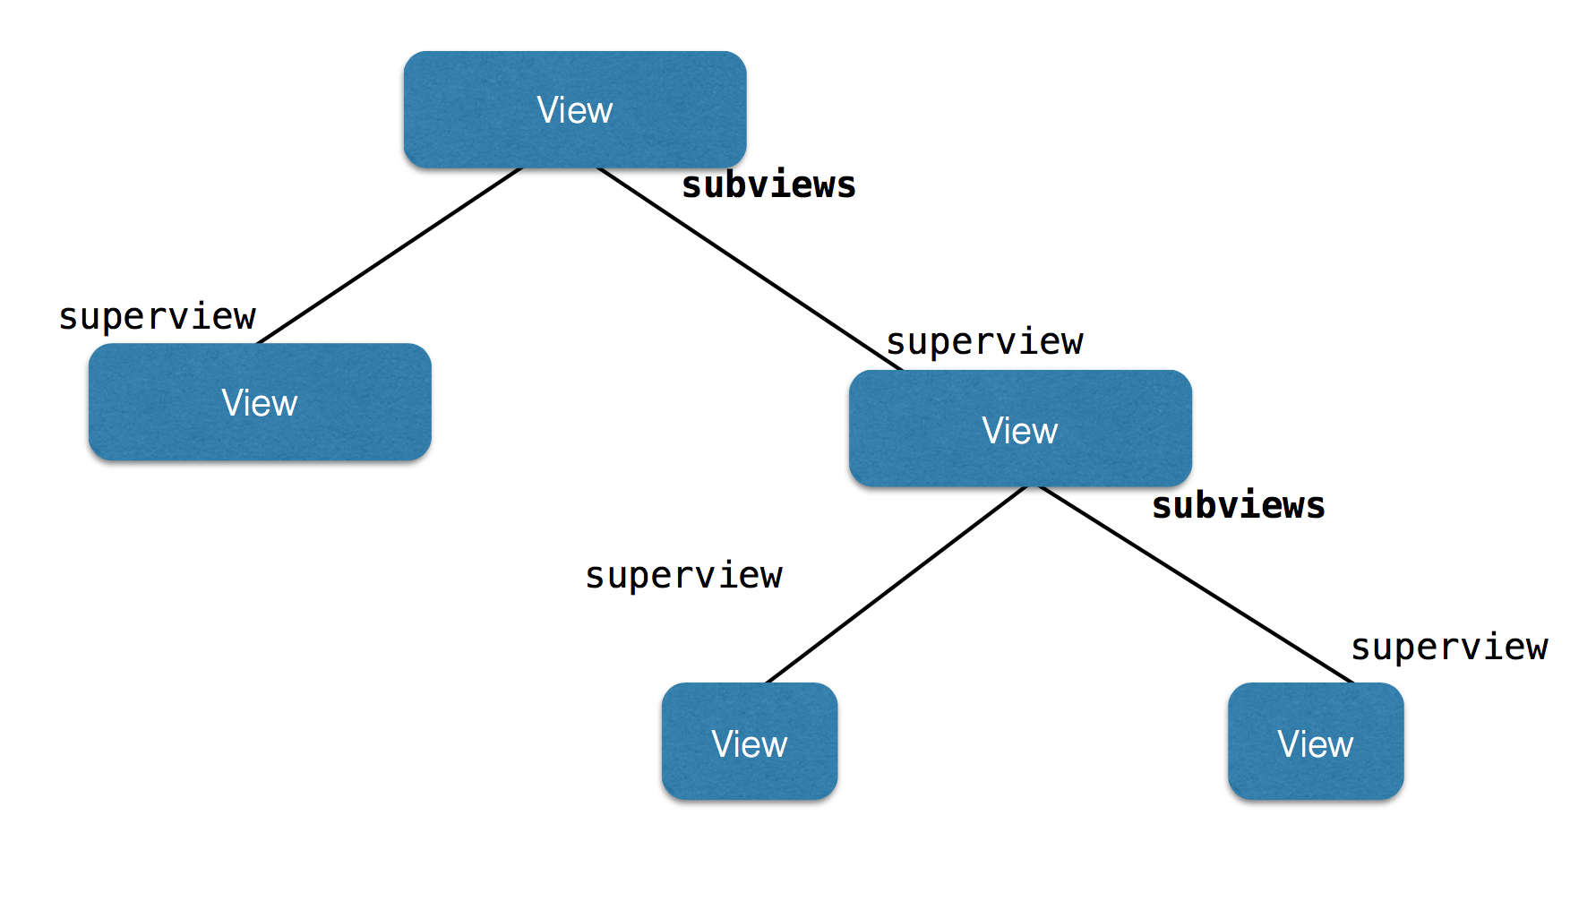
Properties

Slide 5
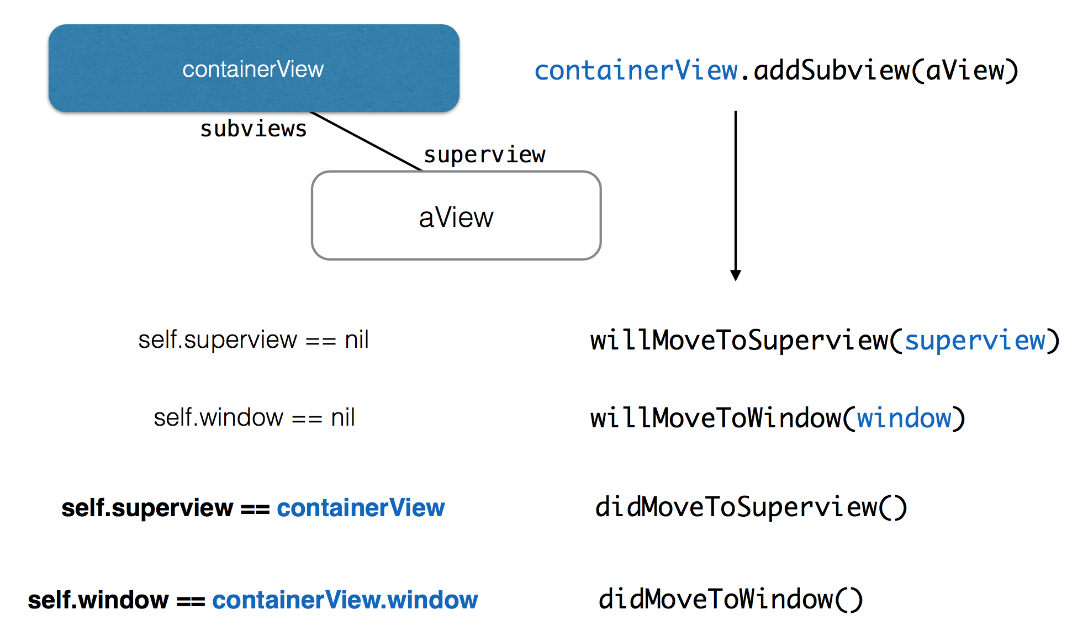
Adding

Slide 6
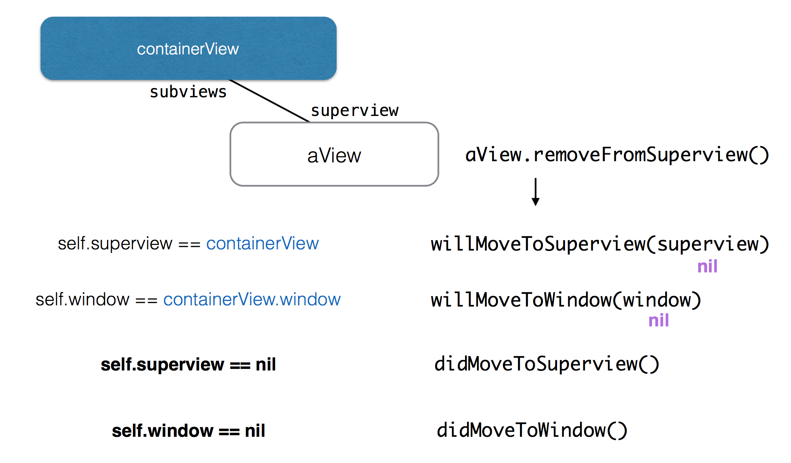
Removing

Slide 7
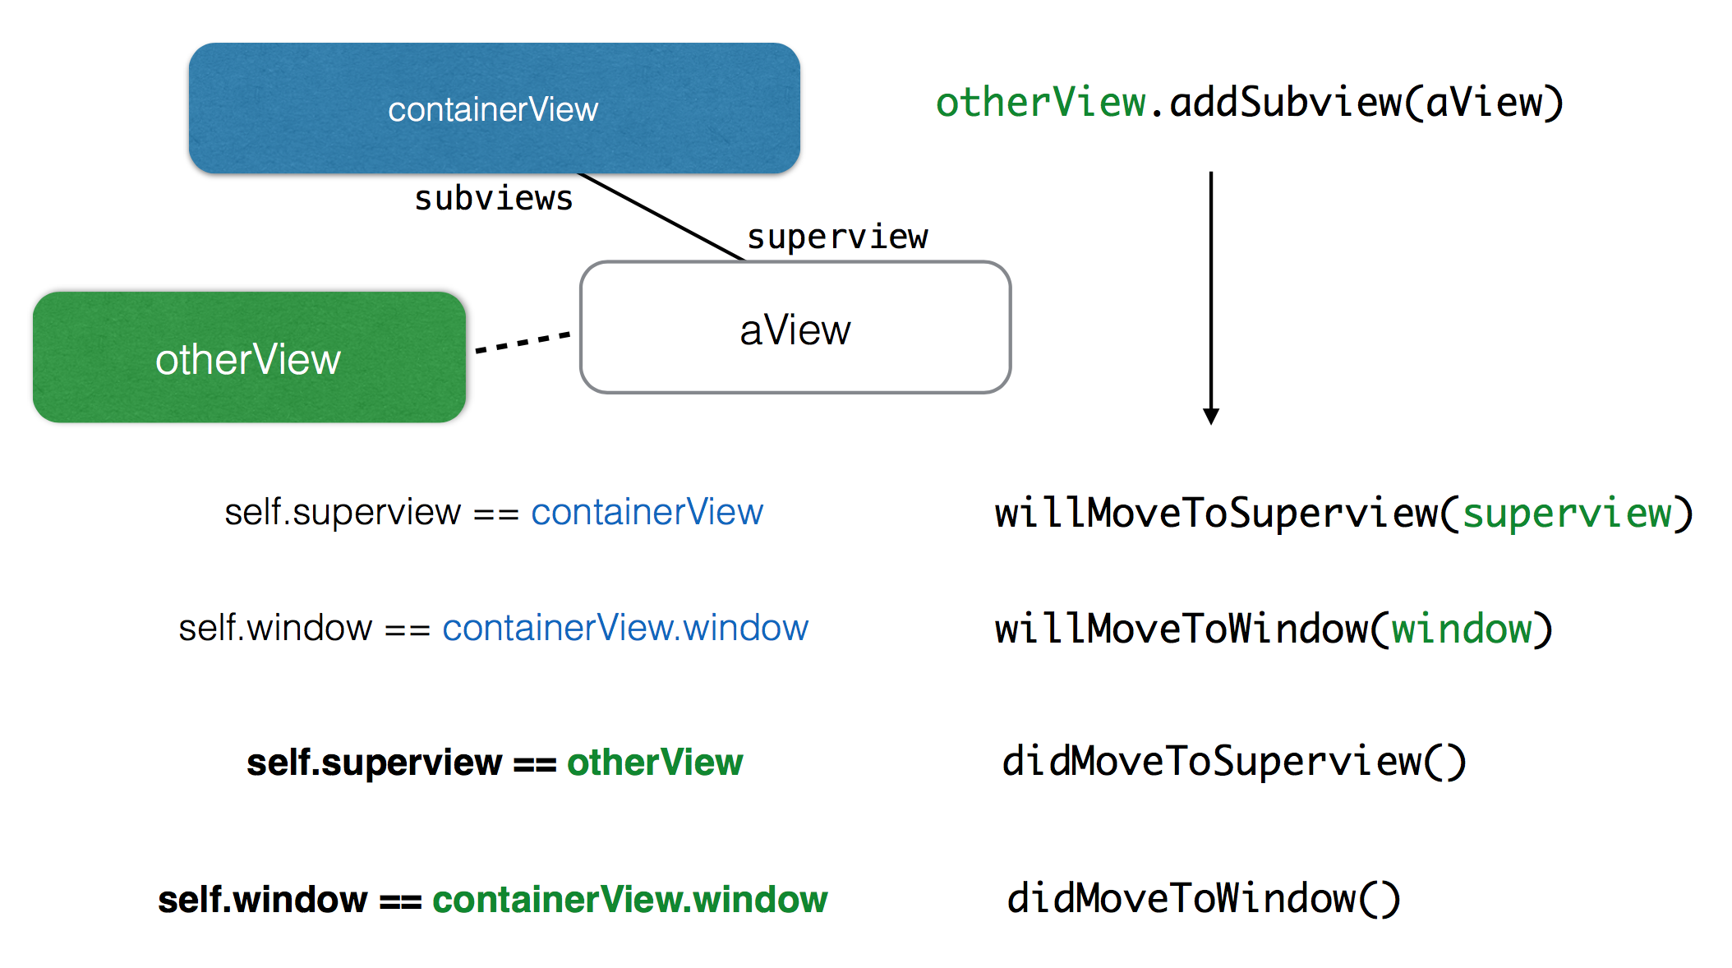
Moving

Slide 8
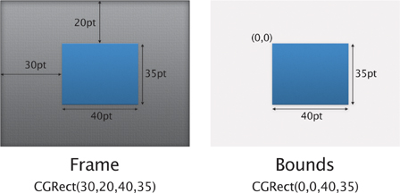
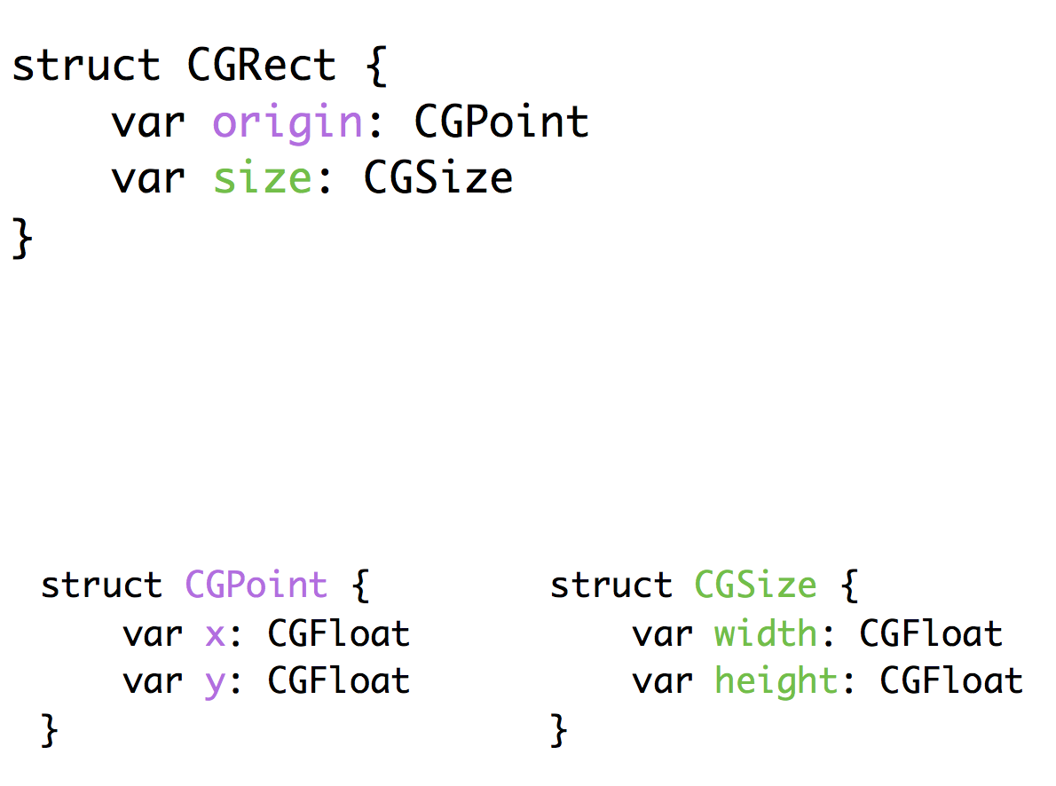
Frame & Bounds

Slide 9
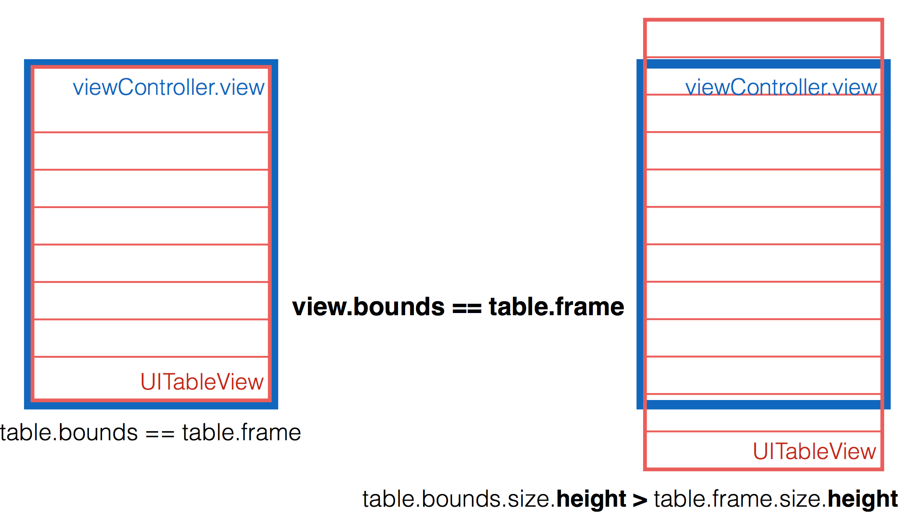
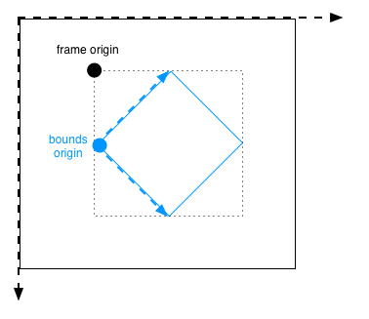
When does the bounds differs

Slide 10
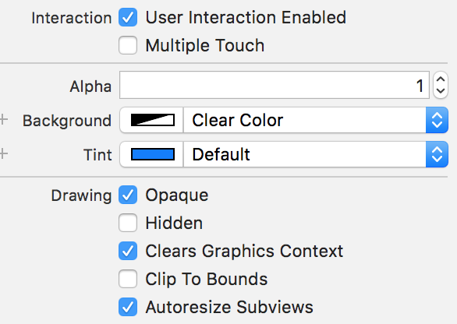
UIView Properties

Slide 11
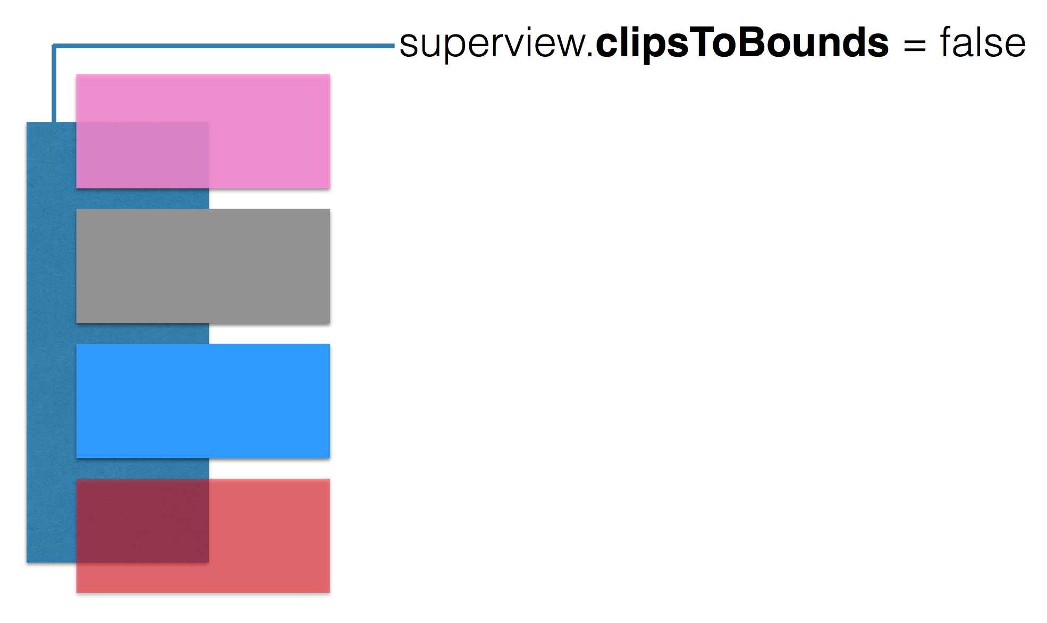
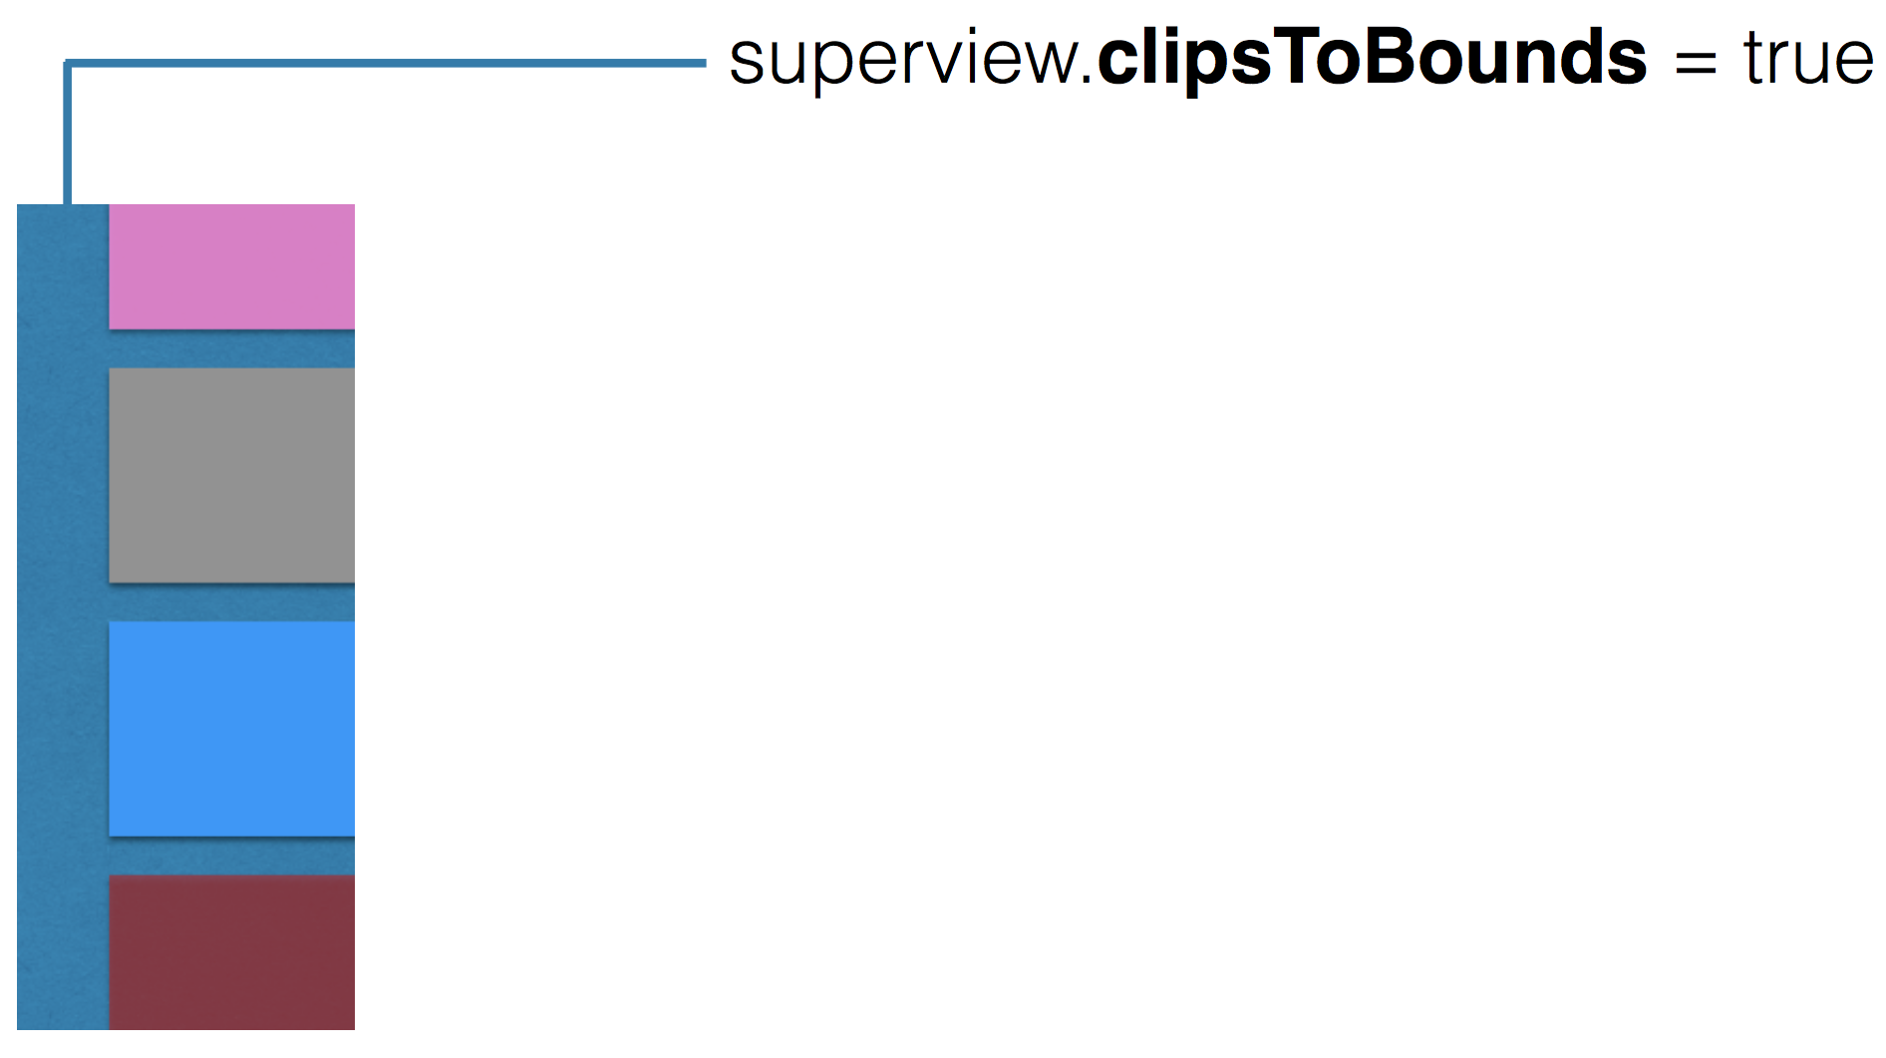
UIView Properties

Slide 12
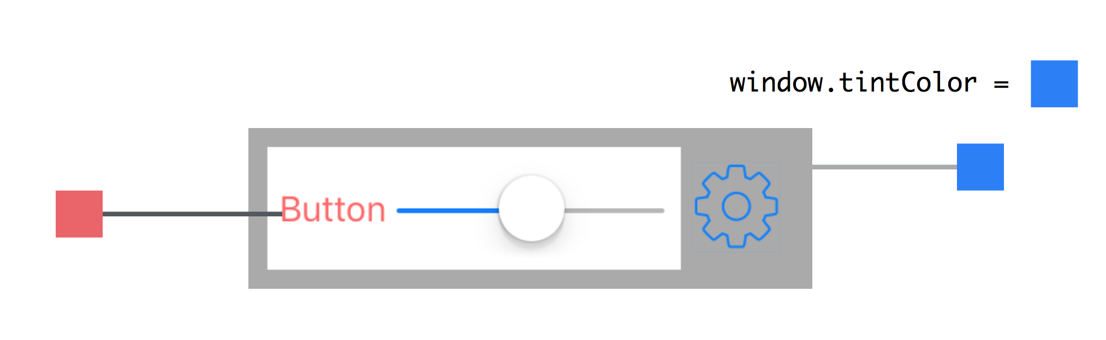
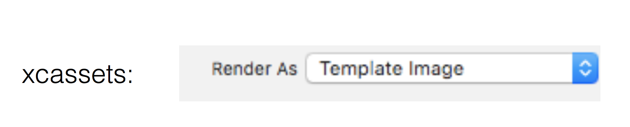
UIView Properties
UIImage + tintColor

Slide 13
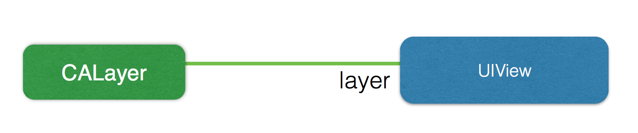
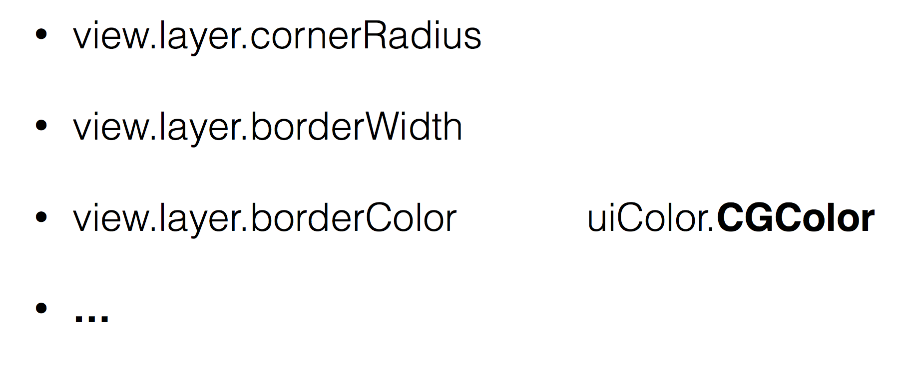
CALayer

Slide 14
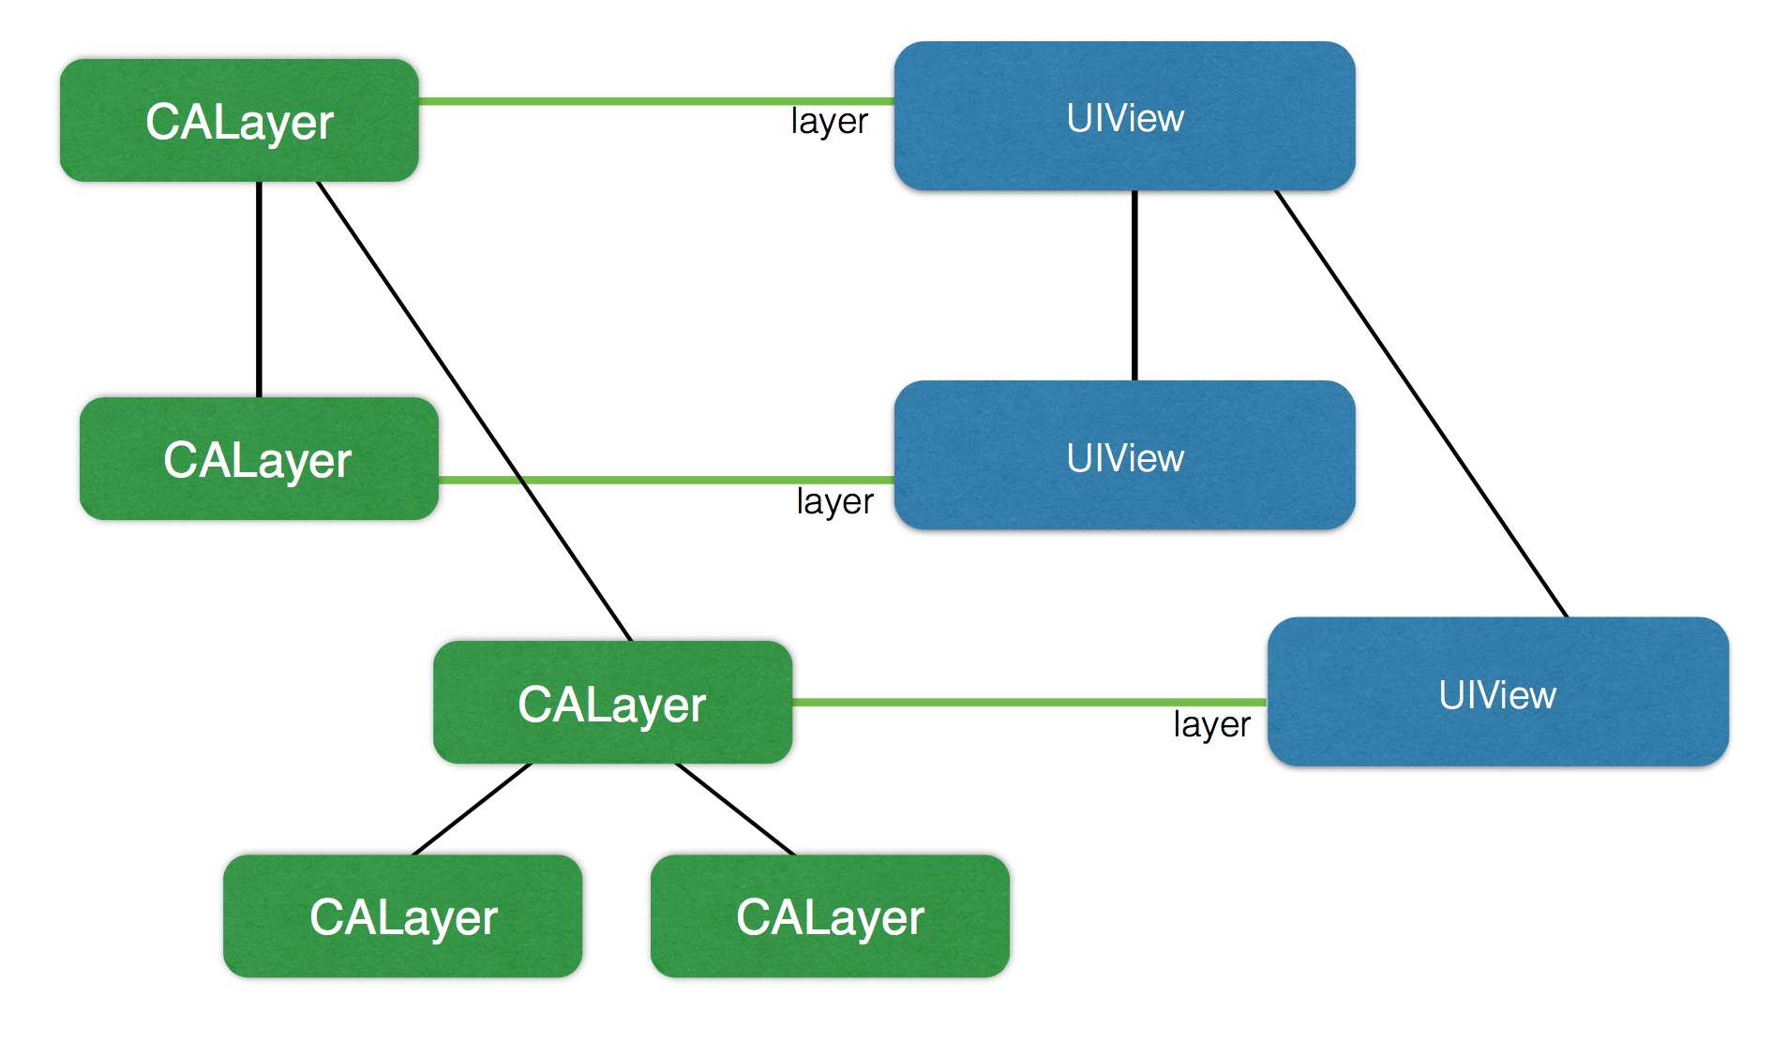
CALayer

Slide 15
CALayer
https://www.raywenderlich.com/90488/calayer-in-ios-with-swift-10-examples
CAShapeLayer
CAGradientLayer
CAScrollLayer
CATextLayer
AVPlayerLayer
CAReplicatorLayer
CATiledLayer
CATransformLayer
CAEmitterLayer

